Slide 1
Chapter 4: Allocating Resources Over Time
Objective
Explain the concept of compounding
and discounting and to provide
examples of real life
applications

Slide 2
Note:
This slide show does not follow the book as closely as shows for the other chapters
Students getting time value of money for the first time need to double or triple exposure to this basic skill
There are many examples at the end of this collection organized into subsections starting at slide 95 of 263

Slide 3
Introduction: Time Value of Money (TVM)
$20 today is worth more than the expectation of $20 tomorrow because:
a bank would pay interest on the $20
inflation makes tomorrows $20 less valuable than today’s
uncertainty of receiving tomorrow’s $20

Slide 4
4.1 Compounding
Assume that the interest rate is 10% p.a.
What this means is that if you invest $1 for one year, you have been promised $1*(1+10/100) or $1.10 next year
Investing $1 for yet another year promises to produce 1.10 *(1+10/100) or $1.21 in 2-years

Slide 5
Value of Investing $1
Continuing in this manner you will find that the following amounts will be earned:

Slide 6
Value of $5 Invested
More generally, with an investment of $5 at 10% we obtain

Slide 7
Generalizing the method
Generalizing the method requires some definitions. Let
i be the interest rate
n be the life of the lump sum investment
PV be the present value
FV be the future value

Slide 8
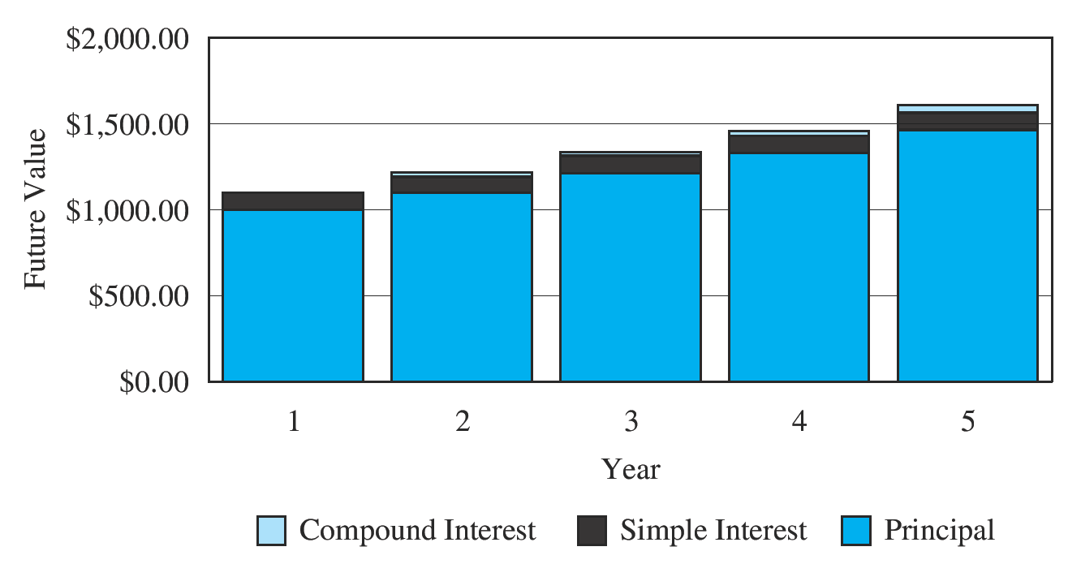
Future Value and Compound Interest

Slide 9
Future Value of a Lump Sum

Slide 10
Example: Future Value of a Lump Sum
Your bank offers a CD (Certificates of Deposit) with an interest rate of 3% for a 5 year investment.
You wish to invest $1,500 for 5 years, how much will your investment be worth?

Slide 11
RULE OF 72
This rule says that the number of years it takes for a sum of money to double in value (“the doubling time”) is approximately equal to the number 72 divided by the interest rate expressed in percent per year
Doubling Time = 72
Interest Rate

Slide 12
Hint: Rounding is common sense “plus” tradition
Its important to round appropriately
In a $ 7 billions project, rounding might be to the nearest $’000,000
Your check book should be rounded to $0.01
In an accounting situation, any unexpected error, however small could be the result of two larger compensating errors. Accordingly, they need to be resolved
Avoid any truncation within a calculation

Slide 13
Hint: Avoid any truncation within a calculation
Engineers study numerical analysis. In fact, it is so important, they may take several courses. Few finance folk have any idea of computational dangers. For now you should be safe if you
Avoid removing intermediate results from your calculator. Store them in a memory register. This avoids input and output copying errors
Learn to use the “stack” or brackets provided by your financial calculator. Your calculator probably keeps a more accurate version of displayed numbers internally
In no case should you ever truncate an intermediate computation unless you fully understand the affect on accuracy (You probably don’t!)

Slide 14
Present Value of a Lump Sum

Slide 15
Example: Present Value of a Lump Sum
You have been offered $40,000 for your printing business, payable in 2 years. Given the risk, you require a return of 8%. What is the present value of the offer?

Slide 16
Lump Sums Formulae
You have solved a present value and a future value of a lump sum. There remains two other variables that may be solved for
interest, i
number of periods, n

Slide 17
Solving Lump Sum Cash Flow for Interest Rate

Slide 18
Example: Interest Rate on a Lump Sum Investment
If you invest $15,000 for ten years, you receive $30,000. What is your annual return?

Slide 19
Review of Logarithms
The next three slides are a quick review of logarithms
I know that you probably learned this in eighth grade, but those of us who do not use them frequently forget the basic rules

Slide 20
Logarithms are important in finance because growth is related to the exponential, and the exponential is the inverse function of the logarithm
Logarithms may have different bases, but in finance we need only the natural logarithm, that is the logarithm of base e.
The e is the irrational number that may be approximated as 2.718281828. It is easy to remember because it starts to repeat, but don’t be fooled, it doesn't, and it is irrational²

Slide 21
Review of Logarithms
The basic properties of logarithms that are used by finance are:

Slide 22
Review of Logarithms
The following properties are easy to prove from the last ones, and are useful in finance

Slide 23
Solving Lump Sum Cash Flow for Number of Periods

Slide 24
4.2 The Frequency of Compounding
You have a credit card that carries a rate of interest of 18% per year compounded monthly. What is the interest rate compounded annually?
That is, if you borrowed $1 with the card, what would you owe at the end of a year?

Slide 25
The Frequency of Compounding
18% per year compounded monthly is just code for 18%/12 = 1.5% per month
All calculation must be expressed in terms of consistent units
A raw rate of interest expressed in terms of years and months may never be used in a calculation

Slide 26
The Frequency of Compounding
The annual rate compounded monthly is code for one twelfth of the stated rate per month compounded monthly
The year is the macroperiod, and the month is the microperiod
In this case there are 12 microperiods in one macroperiod

Slide 27
The Frequency of Compounding
When a rate is expressed in terms of a macroperiod compounded with a different microperiod, then it is a nominal or annual percentage rate (APR)
If macroperiod = microperiod then the rate is referred to as a the real or effective rate based on that period

Slide 28
The Frequency of Compounding
Assume m microperiods in a macroperiod and a nominal rate k per macroperiod compounded micro-periodically. That is the effective rate is k/n per microperiod.
Invest $1 for one macroperiod to obtain $1*(1+k/n)^{n}, producing an effective rate over the macroperiod of ($1*(1+k/n)^{n} - $1)/$1 = (1+k/n)^{n} - 1

Slide 29
Credit Card
If the credit card pays an APR of 18% per year compounded monthly. The (real) monthly rate is 18%/12 = 1.5% so the real annual rate is (1+0.015)¹² - 1 = 19.56%
The two equal APR with different frequency of compounding have different effective annual rates:

Slide 30
Effective Annual Rates of an APR of 18%

Slide 31
The Frequency of Compounding
Note that as the frequency of compounding increases, so does the annual effective rate
What occurs as the frequency of compounding rises to infinity?

Slide 32
The Frequency of Compounding
The effective annual rate that’s equivalent to an annual percentage rate of 18% is then e ^{0.18} - 1 = 19.72%
More precision shows that moving from daily compounding to continuous compounding gains 0.53 of one basis point

Slide 33
The Frequency of Compounding
A bank determines that it needs an effective rate of 12% on car loans to medium risk borrowers
What annual percentage rates may it offer?

Slide 34
The Frequency of Compounding

Slide 35
The Frequency of Compounding

Slide 36
The Frequency of Compounding
Many lenders and borrowers do not have a clear understanding of APRs, but institutional lenders and borrowers do
Institutions are therefore able to extract a few basis points from consumers, but why bother?

Slide 37
The Frequency of Compounding
Financial intermediaries profit from differences in the lending and borrowing rates. Overheads, bad loans and competition results in a narrow margin. Small rate gains therefore result in a large increases in institutional profits
In the long term, ill-informed consumers lose because of compounding

Slide 38
4.5 Multiple Cash Flows
Time Lines
Future Value of a Stream of Cash Flow
Present Value of a Stream of Cash Flows
Investing with Multiple Cash Flows

Slide 39
Time Line

Slide 40
Present Value of Multiple Cash Flows

Slide 41
4.6 Annuities
Financial analysts use several annuities with differing assumptions about the first payment. We will examine just two:
regular annuity with its first coupon one period from now, (detail look)
annuity due with its first coupon today, (cursory look)

Slide 42
Cash Flow Diagram of Annuities

Slide 43
Rationale for Annuity Formula
a sequence of equally spaced identical cash flows is a common occurrence, so automation pays off
a typical annuity is a mortgage which may have 360 monthly payments, a lot of work for using elementary methods

Slide 44
Assumptions Regular Annuity
the first cash flow will occur exactly one period form now
all subsequent cash flows are separated by exactly one period
all periods are of equal length
the term structure of interest is flat
all cash flows have the same (nominal) value
the present value of a sum of present values is the sum of the present values

Slide 45
Annuity Formula Notation
PV = the present value of the annuity
i = interest rate to be earned over the life of the annuity
n = the number of payments
pmt = the periodic payment

Slide 46
Derivation of PV of Annuity Formula: Algebra. 1 of 5

Slide 47
Derivation of PV of Annuity Formula: Algebra. 2 of 5

Slide 48
Derivation of PV of Annuity Formula: Algebra. 3 of 5

Slide 49
Derivation of PV of Annuity Formula: Algebra. 4 of 5

Slide 50
Derivation of PV of Annuity Formula: Algebra. 5 of 5

Slide 51
PV of Annuity Formula

Slide 52
PV Annuity Formula: Payment

Slide 53
PV Annuity Formula: Number of Payments

Slide 54
PV Annuity Formula: Return
There is no transcendental solution to the PV of an annuity equation in terms of the interest rate. Students interested in the reason why are referred to Galois Theory, 2nd. Ed I. Stewart.
Students with a stronger sense of fashion are “seen” carrying Michio Kuga’s poison-ivy-green-colored book “Galois Dream.”

Slide 55
Annuity Formula: PV Annuity Due

Slide 56
Derivation of FV of Annuity Formula: Algebra

Slide 57
FV Annuity Formula: Payment

Slide 58
FV Annuity Formula: Number of Payments

Slide 59
FV Annuity Formula: Return
There is no transcendental solution
Numerical methods have to be employed

Slide 60
4.7 Perpetual Annuities
Recall the annuity formula:
Let n -> infinity with i > 0:

Slide 61
Growing Annuities
Growing annuities solve the super-normal growth problem
They are often more appropriate in day-to-day situations than annuities

Slide 62
4.8 Loan Amortization: Mortgage
early repayment permitted at any time during mortgage’s 360 monthly payments
market interest rates may fluctuate, but the loan’s rate is a constant 1/2% per month
the mortgage requires 10% equity and “three points”
assume a $500,000 house price

Slide 63
Mortgage: The payment
We will examine this problem using a financial calculator
The first quantity to determine is the amount of the loan and the points

Slide 64
Calculator Solution
This is
the monthly
repayment

Slide 65
Mortgage: Early Repayment
Assume that the family plans to sell the house after exactly 60 payments, what will be the outstanding principle?

Slide 66
Mortgage Repayment: Issues
The outstanding principle is the present value (at repayment date) of the remaining payments on the mortgage
There are in this case 360-60 = 300 remaining payments, starting with the one 1-month from now

Slide 67
Calculator Solution
Outstanding @ 60 Months

Slide 68
Summary of Payments
The family has made 60 payments = $2687.98*12*5 = $161,878.64
Their mortgage repayment = 450,000 - 418,744.61 = $31,255.39
Interest = payments - principle reduction = 161,878.64 - 31,255.39 = $130,623.25

Slide 69
Avoid Adding Cash Flows From Different Periods
In the above slide, we broke one of the cardinal rules of finance: We bundled the cash flows for 5-years by adding them together
This kind of analysis can lead to inappropriate financial decisions, such as early repayment of a mortgage

Slide 70
A Result of Breaking the Rule
Given the tax advantages of a mortgage, and the fact it collateralized, their interest rates are quite low
Some financial pundits recommend adding (say 10%) to monthly payments to reduce the mortgage life by 5- to 10-years
At your age, investing that extra 10% in a mutual fund may be more appropriate

Slide 71
A Result of Breaking the Rule
The pundits make their argument by adding (without discounting!) the difference in the cash flows between the scenarios. This is typically a huge sum of money, and this is what is “saved”
When discounted appropriately, there are no significant savings. There are huge opportunity losses for those willing to accept the risk of a stock mutual fund

Slide 72
Outstanding Balance as a Function of Time
The following graphs illustrate that in the early years, monthly payment are mostly interest. In latter years, the payments are mostly principle
Recall that only the interest portion is tax-deductible, so the tax shelter decays

Slide 77
4.10 Inflation and Discounted Cash Flow Analysis
We will use the notation
I_{n} the rate of interest in nominal terms
I_{r} the rate of interest in real terms
R the rate of inflation
From chapter 2 we have the relationship

Slide 78
Illustration
What is the real rate of interest if the nominal rate is 8% and inflation is 5%?
The real rate or return determines the spending power of your savings
The nominal value of your wealth is only as important as its purchasing power

Slide 79
Investing in Inflation-protected CD’s
You have decided to invest $10,000 for the next 12-months. You are offered two choices
A nominal CD paying a 8% return
A real CD paying 3% + inflation rate
If you anticipate the inflation being
Below 5% invest in the nominal security
Above 5% invest in the real security
Equal to 5% invest in either

Slide 80
Why Debtors Gain From Unanticipated Inflation
You borrow $10,000 at 8% interest. The today’s spending power of the repayment is $10,000*1.08/ (1+inflation)
If the actual inflation is the expected 6%, then the real cost of the loan in today’s money is $10,188.68
If the actual inflation is 10%, then the loan’s real cost (in today’s values) is $9,818.18
Unexpected inflation benefits borrower

Slide 81
Inflation and Present Value
A common planning situation is determining how long it takes to save for something
The problem is that the thing being saved for increases in (nominal) price due to inflation
Using a real approach solves this issue

Slide 82
Inflation and Present Value
Illustration
Assume that a boat costs $20,000 today
General inflation is expected to be 3%
At today’s values, you can save at an inflation adjusted rate of $3,000/year, making the first deposit 1-year hence
You are able to earn 12% loans at Honest Joe’s Pawn Emporium ®
When is the boat yours?

Slide 83
Boat Illustration Continued
Solution
The boat is already at nominal value
To convert the nominal rate to the real rate
I _{real} = (I _{nominal} - inflation)/(1+inflation)
= (0.12-0.03)/1.03 = 8.7378641%
Using your calculator
N -> ?; I -> 8.7378641; PV -> 0; PMT -> 3000; FV -> 20000 “=/-”;
Result: n = 5.48years, (6 years w/ change)

Slide 84
Boat Illustration Continued
Conclusion
Given boater makes deposits at the end of each year, the boat will not be hers for six years
Look at the problem from a nominal vantage:

Slide 85
Boat Illustration (Nominal)

Slide 86
Inflation and Savings Plans
We have seen how to compute the number of years it takes to save for something using both real and nominal methods
Another important question is
How much must I save each year in order to achieve a savings goal?
We will reuse the boat problem, but with the assumption that the boater is willing to wait 8-years, but wishes to minimize annual (inflation adjusted) payments

Slide 87
4.11 Taxes and Investment Decisions
Rule:
Invest so as to maximize your after-tax rate of return
This is not at all the same thing as
Minimize the tax you pay (False)

Slide 88
Investing in Tax-Exempt Bonds
In the USA, municipal bonds are exempt from income taxes
Under what circumstances would you be indifferent to investing in an identical bond that pays tax if your marginal rate of tax is (say) 20%?

